Slide 1
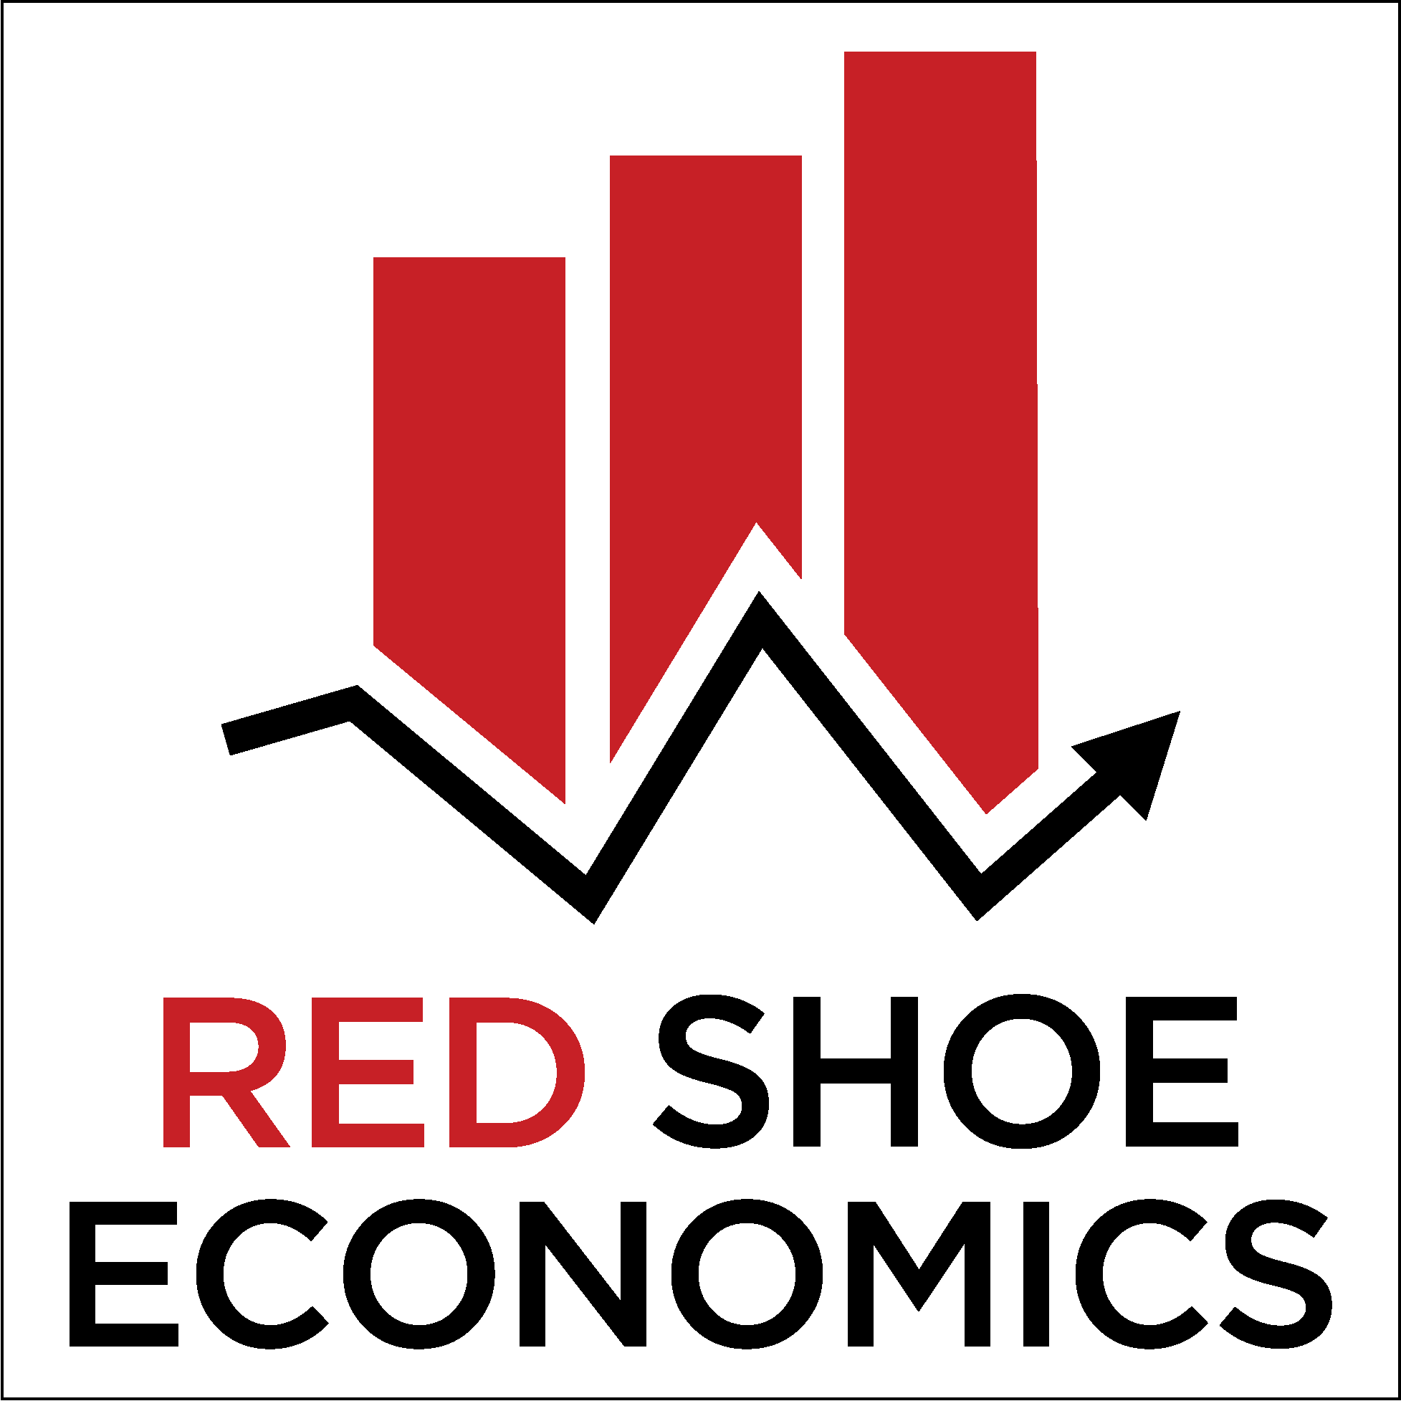

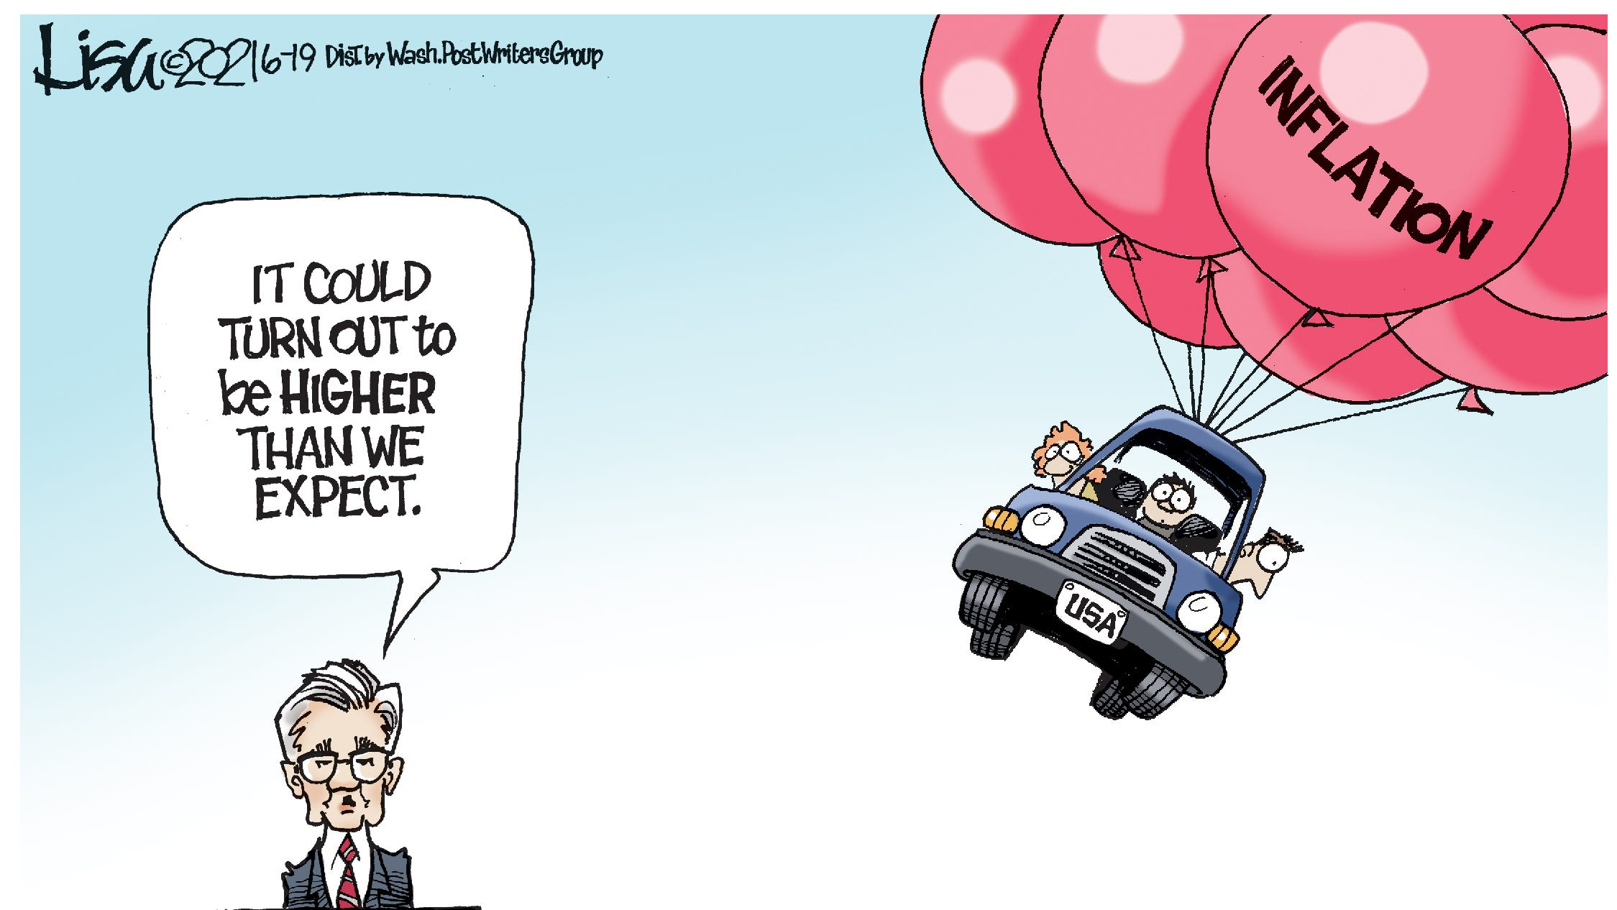
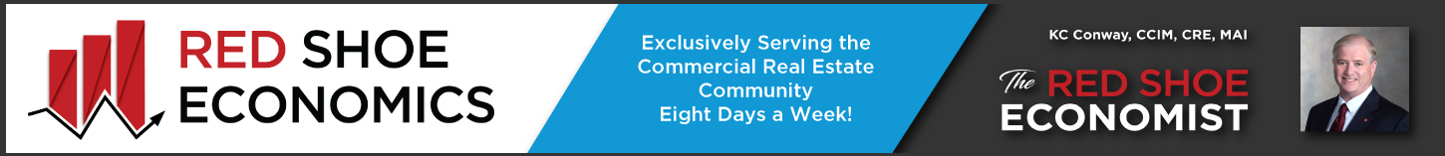

Commercial Real Estate Economic Outlook
August 31, 2022
Follow us on LinkedIn @ Red Shoe Economics
KC Conway, CCIM, CRE, MAI
Principal & Co-Founder of
Red Shoe Economics
KCMAICRE@gmail.com
KC@RedShoeEconomics.com
www.RedShoeEconomics.com

Slide 2

Disclaimer: Not in the fine print…
CCIM MS Chapter Economic Outlook
August 31, 2022
KC Conway, CCIM, CRE, MAI and CCIM Institute Chief Economist
This presentation reflects the analysis and opinions of the author, KC Conway, CCIM, CRE, MAI but not necessarily those of CCIM Institute, CCIM MS Chapter, CCIM MS Chapter Economic Outlook Sponsors, The Appraisal Foundation, UMH (Manufactured Housing REIT), nor Red Shoe Economics.
Neither CCIM Institute, CCIM MS Chapter, CCIM MS Chapter Economic Outlook Sponsors, The Appraisal Foundation, UMH (Manufactured Housing REIT), or Red Shoe Economics make any representations or warranties about the accuracy or suitability of any information in this presentation. The aforementioned do NOT guarantee, warrant, or endorse the advice or services of KC Conway, CCIM, CRE, MAI.
This presentation consists of materials prepared exclusively by KC Conway, CCIM, CRE, MAI and is provided during this event solely for informational purposes of attendees. This presentation is not intended to constitute legal, investment or financial advice or the rendering of legal, consulting, or other professional services of any kind.
RedShoeEconomics.com
2

Slide 3
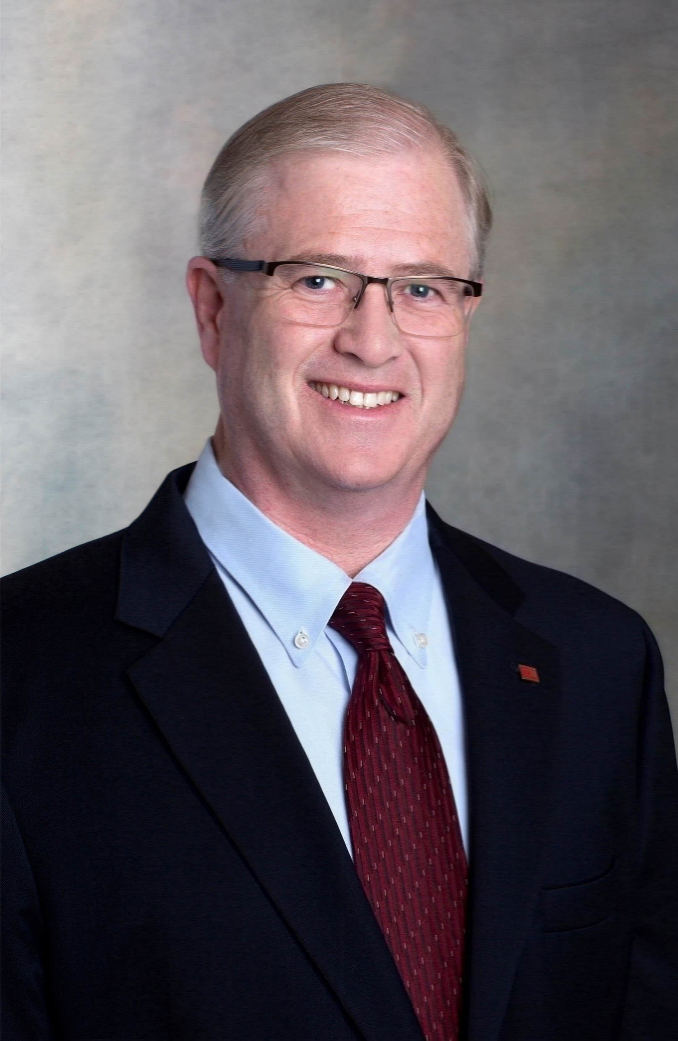
KC Conway, CCIM, CRE, MAI - Short Bio
Professional Roles:
Chief Economist for CCIM Institute (2018 to Present)
Co-Founder and Principal of Red Shoe Economics
EXP Commercial – Economics Advisor (eXp Realty is fastest-growing real estate tech company in the world with >75,000 agents
Instructor for FFIEC (Federal Financial Institutions Exam Council) – Housed at FDIC in DC, FFIEC provides Bank Regulatory Education
Appraisal Foundation – Director, Board of Trustees CY 2022 (AF created by 1989 FIRREA legislation to oversee Appraisers)
UMH (Manufactured Housing REIT) – Added to BOD via Proxy Vote June 2022 succeeding MREIC sale Feb 2022
Education & Professional Credentials:
Emory University Business School – Graduated with Honors 1985
MAI Designation from the Appraisal Institute (1989 to Present)
Counselor of Real Estate (CRE Designation) (2009 to Present)
CCIM Member
Experience:
35 Years as an Appraiser, Bank Regulator, CRE Underwriter and Credit Officer, Economist, Investor, and Expert Witness
Specialize in Adaptive Reuse, Affordable Housing and Housing Economics, Manufactured Housing, Site Selection and Land Use, Rezoning, Economic Impact Studies, Capital Markets and CRE Finance, Ports & Logistics
Advisor to Bank Regulatory Community (FDIC, Federal Reserve, etc.) Since 2005 - Briefed former FED Chair Bernanke
Chief or Senior Appraiser for Wells Fargo Bank, Legacy SouthTrust Bank, Legacy SunTrust Bank
Independent Director to Legacy Monmouth MREIC (50+ year old Industrial REIT Sold to ILPT February 2022)
Published in Numerous Periodicals and Real Estate Journals such as Real Estate Issues, Wall Street Journal, NY Times, FreightWaves, Globe Street, BizNow, Realtors Connections, and Counselors of Real Estate Annual Top-10 CRE Issues
Presented Over 1,000 Times in Past 20 Years to All Major CRE Industry Groups including Appraisal Institute, Am. Bankers Assoc, Am. Property Tax Counsel, Counselors of Real Estate, ICSC, MBA, NAHB, NAIOP, RMA, SIOR, and ULI
Specialty Areas Include: i) Adaptive Reuse; ii) Ports & Logistics/Supply-Chain; iii) Affordable Housing – Especially Manufactured Housing; iv) Property Tax Appeal; v) CRE Finance; vi) Expert Witness Appraisal/Valuation
“If you aren’t evolving, you are becoming obsolete.”
3

Slide 4

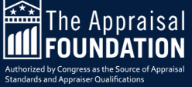
PAVE & PAREA: A CRE Valuation Risk to Monitor – PAREA vs. USPAP?
On June 1, 2021—President Biden announced he was launching an interagency initiative to combat bias in home appraisals. This initiative became the Interagency Task Force on Property Appraisal and Valuation Equity (PAVE).
PAVE is a first-of-its-kind interagency task force dedicated to ending discrimination in home valuations. The task force includes 13 federal agencies and offices and is chaired by Director of the Domestic Policy Council Ambassador Susan E. Rice and the U.S. Housing and Urban Development Secretary Marcia L. Fudge.
Practical Applications of Real Estate Appraisal (PAREA)
PAREA provides another pathway for aspiring appraisers to fulfill their experience requirements.
The Appraiser Qualifications Board created the program as an alternative to the traditional supervisor/trainee model for gaining appraisal experience.
What is PAREA?
The Criteria and Guide Note for PAREA was adopted by the AQB on October 16, 2020 and became effective January 1, 2021. You can read the exposure draft which led to the adoption of PAREA and the revised Criteria.
Why isn’t PAVE focused on LENDERS and GSEs as they hire, review, and accept the appraisals.
https://www.appraisalfoundation.org/
https://pave.hud.gov/about
4

Slide 5
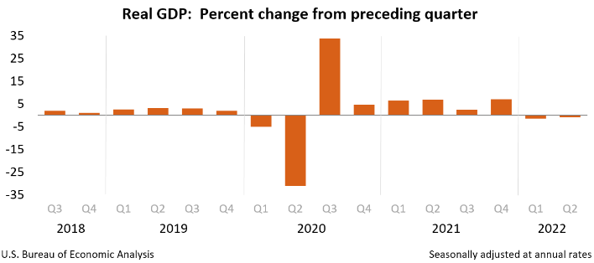

GDP: We are in Recession (NBER won’t call it until 2024)
Two consecutive Quarters of Negative GDP:
Real gross domestic product (GDP) decreased at an annual rate of 0.9 percent in the second quarter of 2022 (table 1), according to the "advance" estimate released by the Bureau of Economic Analysis.
In the first quarter, real GDP decreased 1.6 percent.
Q4 ’21: +6.9%
Q1 ‘22: -1.6%
Q2 ‘22: -0.6%
5
https://www.bea.gov/news/2022/gross-domestic-product-second-quarter-2022-advance-estimate

Slide 6
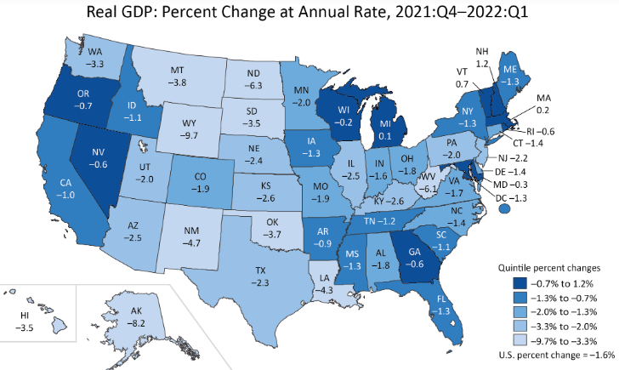
GDP by State: Only 4 states with Positive GDP (Q1 BEA Report)
With ONLY 4 states with POSITIVE GDP in Q1 2022 (NH, VT, MA and MI), how can GDP turn positive in Q3 or Q4 2022? Expect 4 consecutive quarters of negative GDP in 2022.
The Red Shoe Economist’s
GDP Forecast for 2022:
Q1 ’22: -1.6% (F)
Q2 ‘22: -0.6% (Revised #1)
Q3 ‘22: -2.0%
Q4 ‘22: -2.5%
CY 2022: -2.0%
Why 4 Consecutive Qtrs. Neg?
Strong US $ hurts exports
45 of 50 states Neg GDP
Drought in West & Plains
Supply-Chain still broken
Drought & WATER restricted states in West and Plains have the most GDP contraction in 2022
WY: -9.7%
UT & AZ: -2.0%
KS & NE: -2.5%
DROUGHT
6
https://www.bea.gov/news/2022/gross-domestic-product-state-1st-quarter-2022

Slide 7
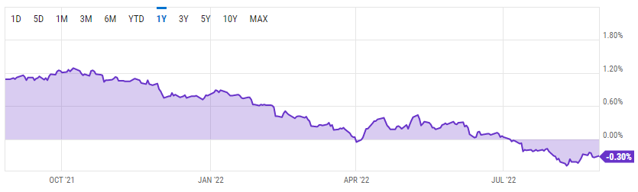
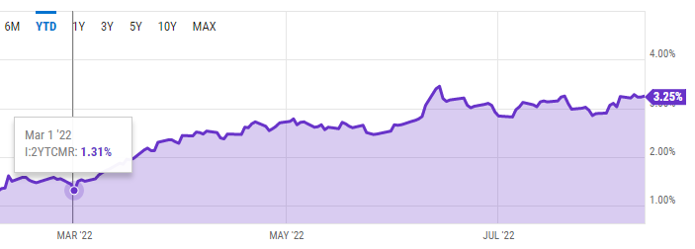
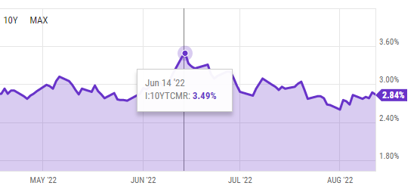
Yield Curve Inversion: 10/2-Year Inversion = Recession
-0.30% Tuesday Aug 30 as 10-Yr rose back above 3% on Hawkish View from FED Chair in Jackson Hole WY
Yield Curve Inversion: The 10Yr vs 2Yr was most negative in 2022 @ -45bps on Aug 9, 2022)
Q. Why worsening/widening?
A. Fed Rate Hikes to continue.
Yield Curve Inversion: 10-Yr. Tr falling from Jan high of 3.49% to 3.12% .
Why the Drop? The Mkt. was NOT believing in a Recession until FED WY
Yield Curve Inversion: 2-Yr. Tr 3.45% Aug 30 up from 1.3% March 1. Why the Increase? – The 4 Fed Rate hikes that started at March FOMC meeting and FED Hawkish outlook from WY
7
https://ycharts.com/indicators/10_2_year_treasury_yield_spread

Slide 8
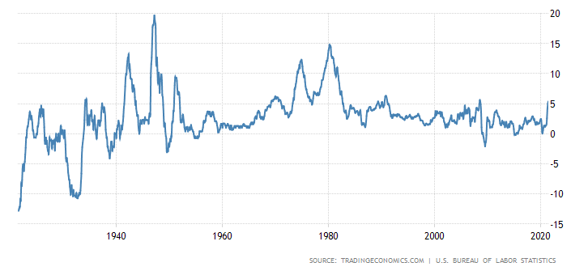
INFLATION: Historical Perspective (Repeat 1977-1981?)
The Great Inflation (1965-1982) was the defining macroeconomic period of the second half of the twentieth century.
What caused 1% to 14%?
1960s Vietnam War Deficit spending
1971 Off the Gold Standard / Rise of Bitcoin
1973 Arab Oil Embargo / Supply-Chain
1974 Nixon Price Controls / FED’s Balance Sheet
Bad Data & Fed Policy / Unchanged – No Supply-Chain
WW II War-Time & then Peace-Time Economy
1940 - 1950
1973-1981
Inflation 1% in 1964 Unemployment @ 5%;
Inflation 14% in 1980 Unemployment @7.5% WHY?
Note 2 Key Points:
#1 – Inflation didn’t straight-line increase 1973-1978. July’s drop was a head-fake due to SPR Releases that end in Oct.
#2 – 10/2 Yield Curve Inversion -41bps
(2Yr vs 10Yr) worsens ( 2Yr 3.25% vs 2.84% 10Yr Aug 12)
1971: Nixon takes US off “Gold Standard”
Bretton Woods, NH System 1941: “The Gold Standard”
Employment Act of 1946 – Where Fed’s mandate for “Full Employment” originated
Humphrey-Hawkins Act of 1978 gave FED it’s 2nd Mandate of “Price Stability”
Mandate #1
Mandate #2
8
https://tradingeconomics.com/united-states/inflation-cpi

Slide 9
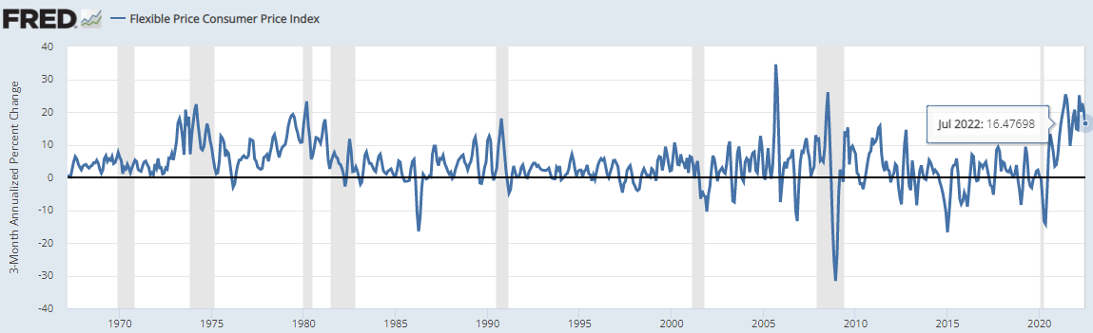
St. Louis FED’s “Flexible CPI”: The REAL Household Inflation Rate
FLEXIBLE CPI by St. Louis FED:
Inflation is NOT Transitory … It’s 1970’s SYSTEMIC
  Follow St. Louis FRB’s FRED & Flexible CPI
  Flexible CPI: 23.23% March 1980 | 25.10% March 2022
  It has Come down in June & July to 16.5% range – WHY?
  SPR Releases, States suspending State Gas Taxes and ENERGY component is offsetting the rise in Food, Wages, and Used Car Prices.
https://fred.stlouisfed.org/series/FLEXCPIM679SFRBATL
9

Slide 10
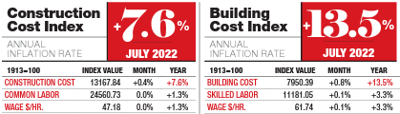
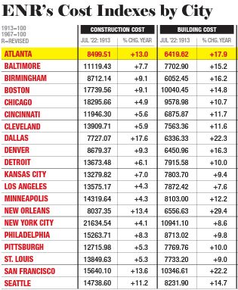
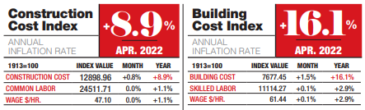
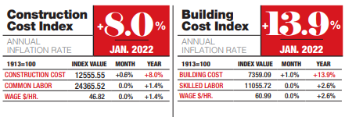
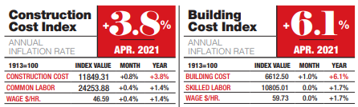
Inflation for Construction is Moderating: Cost of NEW is High – Cost Overruns?
Construction Loans and Cost Overruns?
Principle of Substitution & Cost Approach
July ‘22 more than 2X Apr ‘21
MSAs with
5 Highest Construction Costs:
NOLA, Dallas, SF,
Atlanta, Denver
Atlanta +17%
Birmingham +16%
10
https://www.enr.com/articles/54392-construction-economics-for-july-11-2022

Slide 11
CPI: Why “Flat?”: It’s a head-fake due to Energy & SPR Releases
"Don't get scared, get prepared." Inflation has NOT peaked, and 1-month of data does not make a trend.
The Red Shoe Economist remains in the camp that:
1. Inflation has not peaked. It is still +8.5% YOY for "All Items" and +5.9% CORE taking out Food & Energy (the items that households spend most on after housing). The real household inflation rate is St. Louis Fed's "Flexible CPI" (+25%).
2. Food Inflation is still rising, up another 10.9% YOY and +1.3% in July for the Food Index part of CPI. It's going to get worse this Fall with global wheat shortages, US drought impacting Plain-States wheat and corn yields, and housing shortages. The price for a loaf of bread will likely surpass the price for a gallon of gasoline by this Fall.
3. Energy Index and Gasoline prices drop in July due to the Biden releases from the Strategic Petroleum Reserve (SPR) is what really happened to cause the July CPI to come in Flat. The Energy Index dropped 7.7% in July on heels of a +11% increase in June (pre-SPR release impact into the market). The Energy Index component of CPI is still up 32% YOY. Guess when the SPR Release will end and no longer mask the "All Items" CPI? October and right before the Nov Elections - Hummm?
4. Final Inflation point is wages. Yesterday we got the news that Labor Costs were up 10.8% for Q2. With strong jobs reports anticipated in August and September, and the aforementioned context, The Red-Shoe Economist forecast is for more Fed Rate hikes when they return from Jackson Hole WY meetings/play at their Sept and Fall FOMC meetings.
Now you know the "Rest of the Story" on today's CPI figure as the late Paul Harvey taught us industry economists.
July CPI headline is flat (0%) month-over-month and better than +1.3% increase in June.
What happened and why?
The real takeaways are:
Energy/Gasoline decline masked the increases in Food, shelter, Used Car Prices, etc. thanks to Strategic Petroleum Reserve (SPR) releases (which will dissipate by October right before the Nov Elections); and
1-month does not make a trend or peak in Inflation.
Wait until AFTER last SPR Release in October!
11

Slide 12

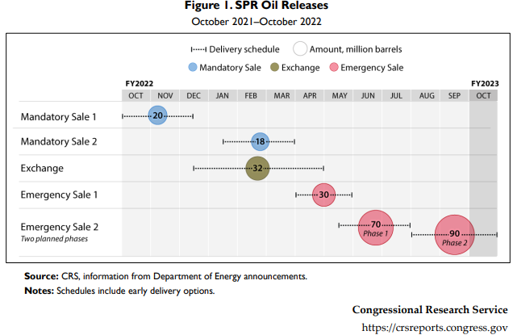
Inflation Skewed DOWN by SPR: SPR Releases & Key Dates
US SPR Releases Set To End This Fall - Jul 25, 2022
The US will end SPR releases as scheduled this fall.
Special Coordinator Hochstein: "We can't be an oil supplier. It's a reserve and so we have to keep that,"
The plan, announced in April, saw a total of 180 million barrels of crude being released from the Strategic Petroleum Reserve to counter the inexorable increase in oil prices amid a tight market, at a rate of some 1 million bpd. Some of that oil reportedly ended up getting exported, including to China.
When the plan was announced, there were warnings that it could backfire, pushing prices higher instead of lower because the SPR would need to be replenished after this substantial draw.
IN11916 (congress.gov)
U.S. SPR Releases Set To End This Fall | OilPrice.com
12

Slide 13
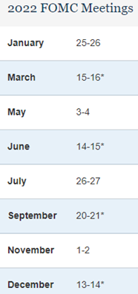
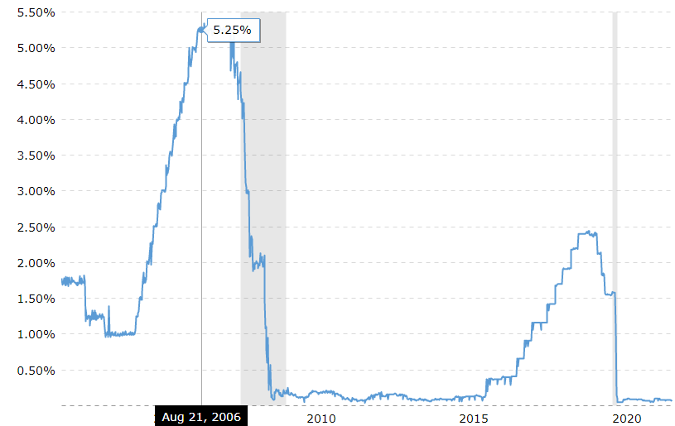
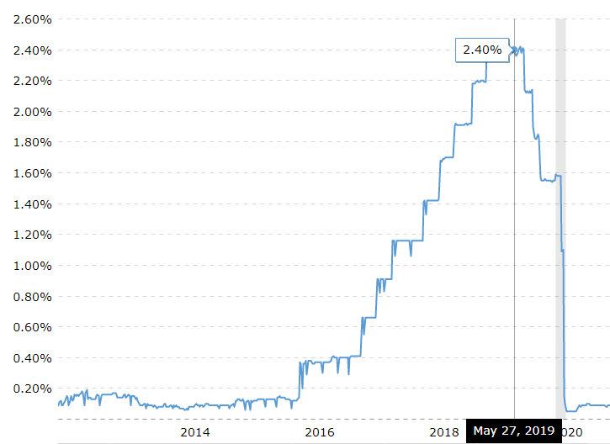
History of FED Rate Hikes: They don’t just hike 3 to 4 times – try 8+
Fed Funds Rate – FOMC Rate Hikes
20-Yr View (1% to 5.25% 2004-Summer 2006)
Fed Funds Rate – FOMC Rate Hikes
10-Yr View (0.20% to 2.40% 2014-Spring 2019)
+ 0bps
2018 “Taper Tantrum with just 4 rate hikes in 1 year and <2% Inflation.
Extrapolate forward to 7%+ Inflation in 2022. The FED is way behind on this Inflation Surge and will need more than 4 hikes – think 6-8 by mid 2023.
This was the pre-Housing Crisis rate increase cycle to head off then housing inflation.
Refer to the 1976-1981 inflation with rate hikes to a 21% Prime Rate.
+25bps
+50bps
+75bps?
+75bps?
+50bps to +100
+50bps to +100
So much for “gradual & transparent.”
Listen to
WY FED speeches from Jackson Hole WY
13
https://www.macrotrends.net/2015/fed-funds-rate-historical-chart

Slide 14
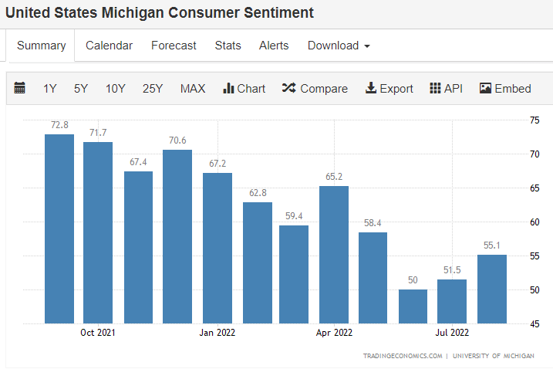
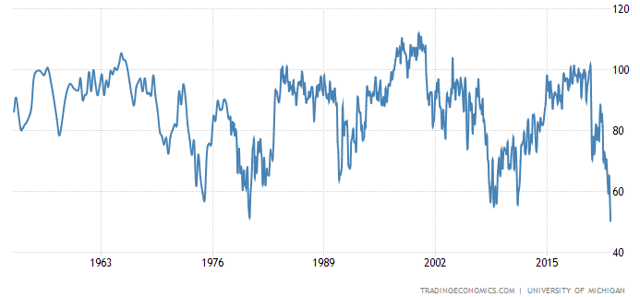
Consumer Confidence bounced in August off June Record low (Univ. of MI)
Consumer Confidence Rebounded in August (55) after a record low in June (50).
Why? Energy Price drop from SPR Releases. … What will Univ of MI Consumer Confidence look like in Q4 after SPR Releases end?
The Michigan consumer sentiment in the US fell sharply to a record low of 50.2 in June of 2022, well below market forecasts of 58, preliminary figures showed. The current economic conditions subindex sank to an all-time low of 55.4 (vs 63.3 in May) and the expectations gauge plunged to 46.8, the lowest since May of 1980. Consumers' assessments of their personal financial situation worsened by 20%.
46% of consumers attributed their negative views to inflation, the biggest share since 1981.
Univ. of MI Consumer Confidence – Record Low in June!
58.7 June 1980
50.2 June 2022
https://tradingeconomics.com/united-states/consumer-confidence
14

Slide 15
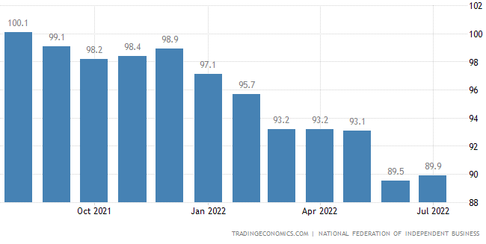
NFIB Small Business Confidence is UP as Energy Cost Decline
NFIB Small Business Index:
The NFIB Small Business Optimism Index in the United States edged higher to 89.9 in July of 2022 but remained close to a 9-1/2-year low of 89.5 hit in June, pointing to a subdued level of confidence, well below the historical average of 98. 37% of business owners reported that inflation was their most important problem and 49% had job openings they could not fill. This Index is a bellwether for CRE leasing activity.
https://tradingeconomics.com/united-states/nfib-business-optimism-index
15

Slide 16
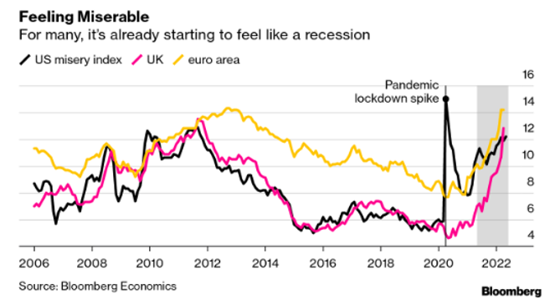
The Misery Index: US & Europe Miserable
The Old Misery Index
The last time we had high inflation in the US was in the 1970s. An economist, Arthur Okun, created a simple misery index by adding the nation’s annual inflation & unemployment rates. Dubbed STAGFLATION, several years of high inflation and high unemployment yielded a misery index of 12.7% in 1976.
The New Misery Index
Things in the economy have changed since the 1970s - most notably more people own stocks. The new misery index adds the inflation rate to the unemployment rate while subtracting GDP growth and the annual increase in the S&P 500. If the new misery index is negative, people are happier than if it is positive. Sadly at 29.2, the new misery index is higher than it has been in the last 12 years.
Inflation rate: 8.3%
Unemployment rate: 3.6%
GDP growth: -1.4%
S&P 500 change: -15.9%
Totals 29.2
16
https://www.forbes.com/sites/petercohan/2022/05/17/new-misery-index-at-12-year-high/?sh=480337b32ac9

Slide 17
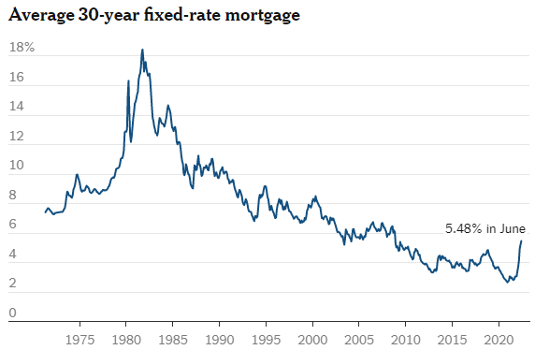
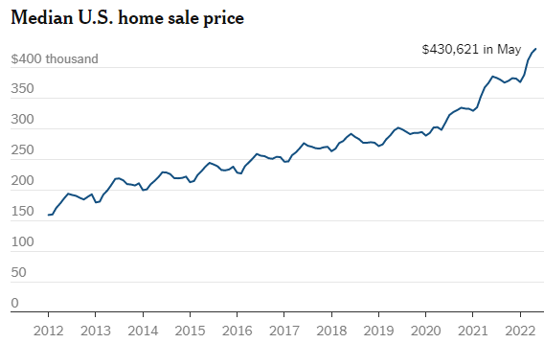
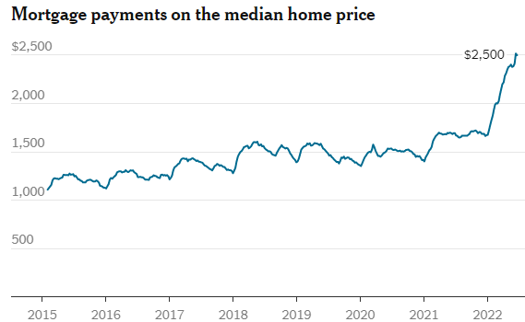
What’s Up With the Housing Market? Affordability not Inventory
3.5% to 5.5%
$300k to $430k in <2 years
Rising mortgage rates. Faltering home sales. Skyrocketing prices.
How to make sense of a baffling housing market.
It’s NOT just an INVENTORY challenge.
It’s AFFORDABILITY!
$1,500/mo. to $2,500/mo. in
2 years
17
https://www-nytimes-com.cdn.ampproject.org/c/s/www.nytimes.com/2022/07/08/realestate/housing-market.amp.html

Slide 18
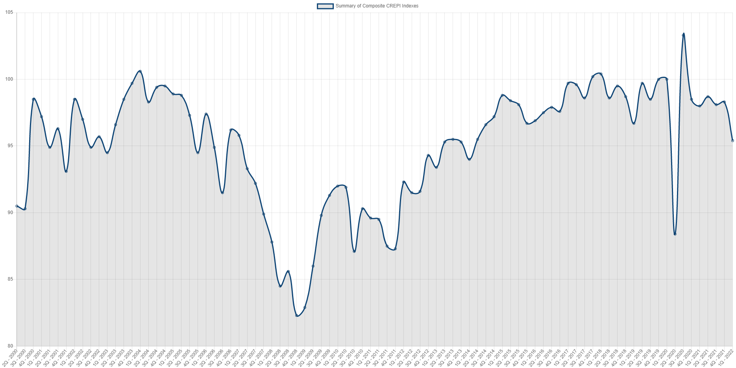

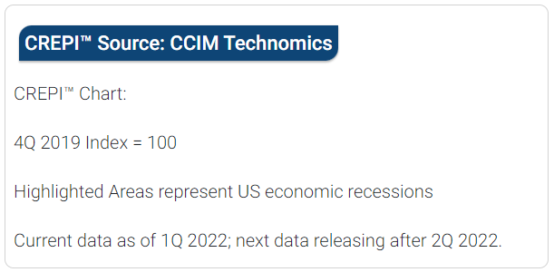
CCIM-TECH’s CREPI™ Report | A Broader Measure of the Economy
103 Range (Q4 ‘21)
Go to www.stdb.com to view CREPI™
It is public – NO LOG-IN required.
95 Range
(Q1 ‘22)
Going <90 (Q2 ’22)
82 Range
This index is from CCIMTECH
https://www.stdb.com/crepi
18

Slide 19
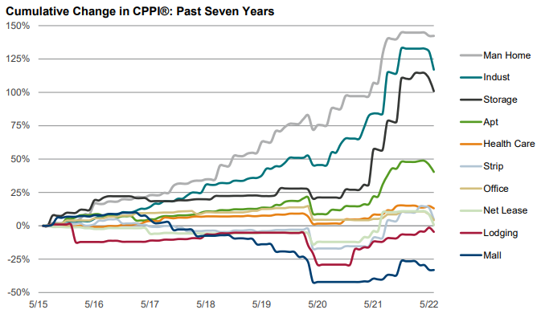
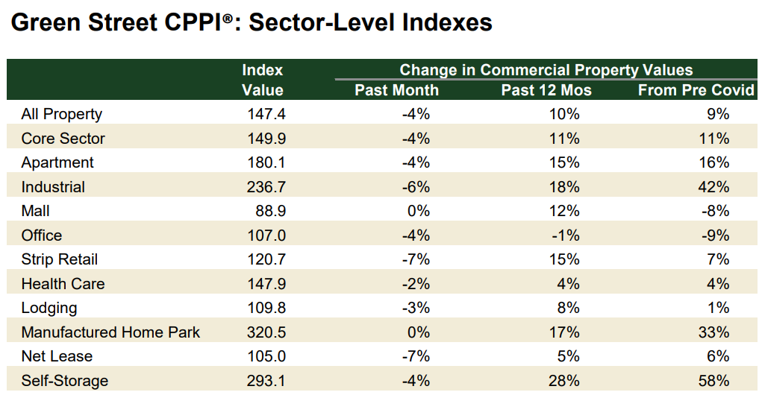

CRE Values: Increases are Slowing / Sustainable?
Cap Rates and Property prices have not gone the path of the major stock market indices. According to Green Street CPPI, commercial real estate prices have risen over the past 3 and 12 months, however, they declined by 3.7% in June. The all-property index is now down 4.9% from its March high.
Does this turn in CPPI foretell that commercial real estate is the next asset class to feel the affects of rising Inflation, rising Interest Rates and a slowing economy as is being revealed in the current round of corporate earnings?
The Key CRE Value Question for 2H 2022:
What is the CRE Value impact if Expenses rise more than rents (NOI/revenue) (7-10%+ vs 3%-5%)?
Are lenders, Investors and Appraisers ready for this wrinkle in 2H 2022?
Green Street CPPI Past 12 Mos (June ‘22 YOY)
#1 – Self Storage: +28% / +58% YTD in Aug GS report
#2 – Industrial: +18% / +42% YTD in Aug GS report
#3 – Manufactured Housing: +17%
#4 & #5 TIE – Strip Retail: +15% & MF: +15%
All Property: +10%
WORST: Office at -1%
19
https://www.greenstreet.com/insights/CPPI

Slide 20
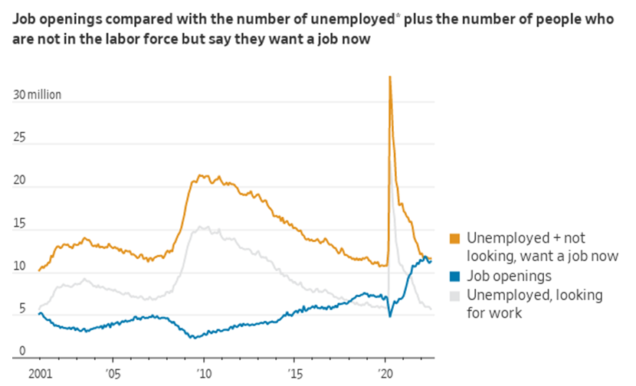
WORKFORCE: A Broader Definition of Potential Workers
Labor Market Historically Tight
A person is considered unemployed if they do not have a job, have actively looked for work in the prior four weeks, and are currently available for work.
Source: Labor Department via St. Louis Fed (seasonally adjusted)

Slide 21

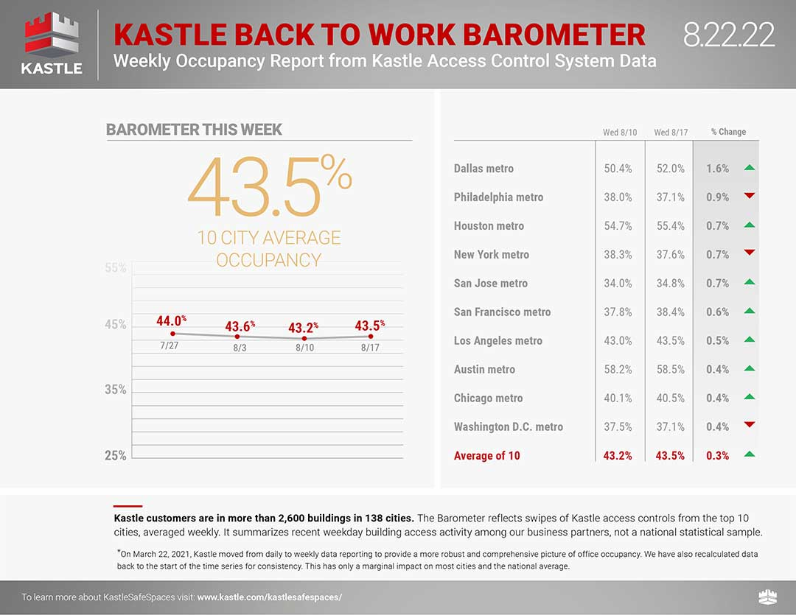

Office & Remote Work:
c
c
There are NO MSAs
outside TX above 45% occupancy.
TX (Austin, Houston & Dallas) have the highest
“Back to Work” ratios at 58%, 55% & 52%
Despite vaccinations & boosters less than half of us are returning to the office!
https://www.kastle.com/safety-wellness/getting-america-back-to-work/#workplace-barometer
21

Slide 22
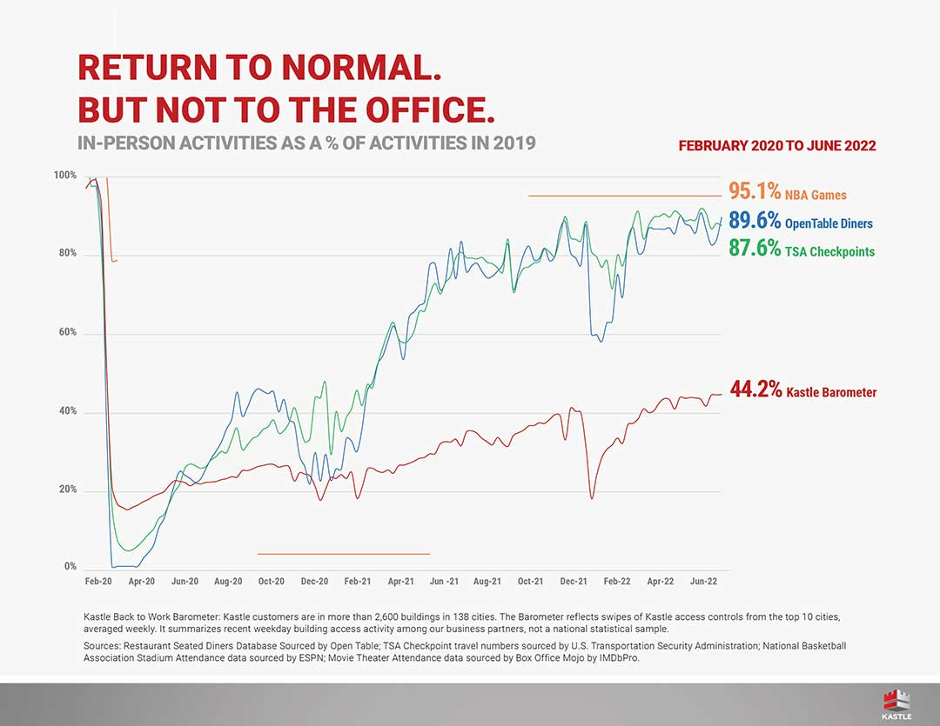
Return to Airports, Basketball & Dining Out: 95.1% vs 44% Return to Office
https://www.kastle.com/safety-wellness/getting-america-back-to-work-recreation-vs-office-occupancy/
22

Slide 23
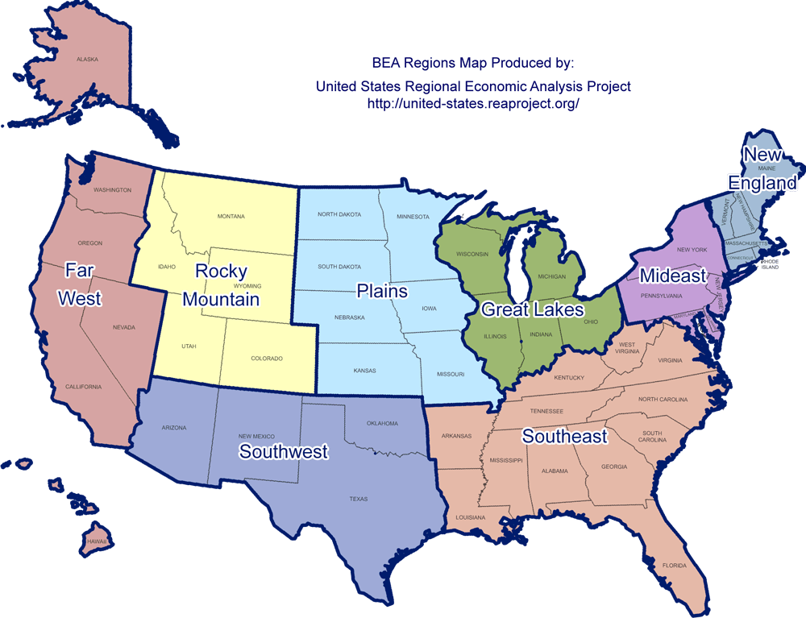
“Golden Triangle” – The Heart of Logistics Infrastructure
More North/South (Port Laredo & Gulf North) than West/East from CA to CHI
Remaking the Supply-Chain – A GREAT story for Mid-Central & SE US
The GDP Golden Triangle
Q. What is it about the “Golden Triangle” that makes it tops in GDP, Logistics & Supply-Chain?
A. The best “Freightways!”
Amazon’s HQ2 Finalists:
15 of 20 Finalists were located within the
“Golden Triangle”
The Golden Mfg. & Logistics Triangle:
SE (#1 @ 22%) + SW + Great lakes
47% US GDP
(GT: 1/3rd states = 50% GDP)
23

Slide 24
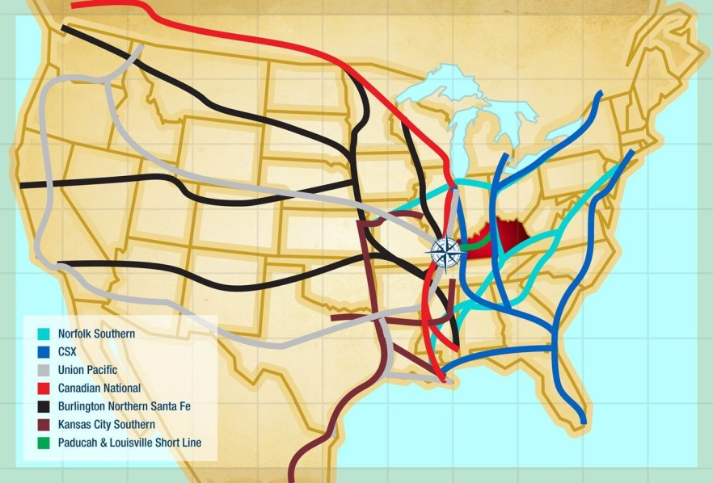
Remaking Supply-Chain to N/S: Rail Connectivity (Inland Port, Intermodal, etc.)
The 7- Class I RRs Note: CN (Red) KCS (Brown) CSX (Blue)
KC Southern:
Only Direct Route to all of Mexico
Link KCS with BNSF or CSX to Create a Mega RR/E-Commerce Power!
CSX:
The East Coast RR Line Serving East Coast Ports
CSX and NFS are to SE & Mid-Atlantic what UP is to CA & West Coast
Rail Mergers are on the Horizon Post-COVID (Financially ‘Weak’ Merges with ‘Strong’ Wanting SE & Gulf Reach)
AAR.org – American Assoc. of RRs
Port Freeport:
3 Class 1 RR Connections
‘Saudi Arabia’ of Natural Gas
The ‘Port of Savannah’ for Dallas
Port of Mobile:
5 Class 1 RR Connections
Only CN to Gulf RR Connection
New Walmart Container Terminal
Airbus + Auto Mfg. State (Mercedes)
New RoRo by 2022/Rebuild AL Bill to Fund
24
https://westfaironline.com/147540/connecticuts-infrastructure-conundrum-persists-amid-renewed-focusconnecticuts-infrastructure-conundrum-persists-amid-renewed-focus/

Slide 25
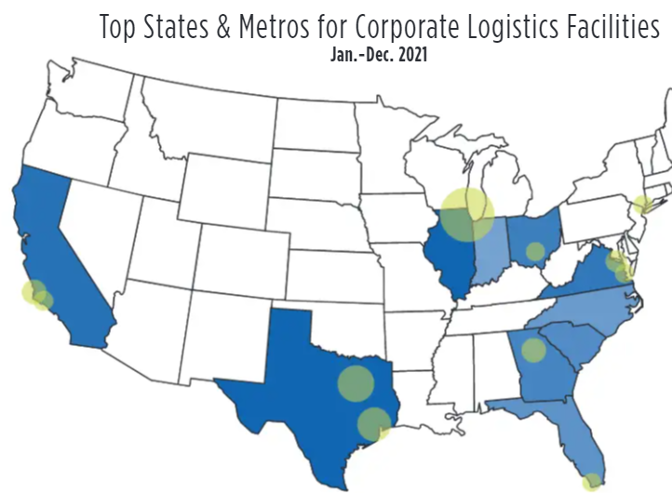
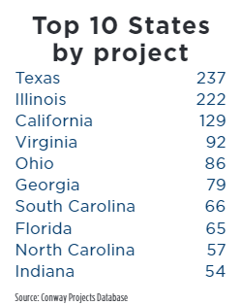
Remaking US Supply-Chain: All but 1 of Top 10 are SE/MW, TX Ranks #1!
Wichita KC Bombardier HQ
AR Inland Port
AL Inland Port
25
https://siteselection.com/issues/2019/sep/logistics-grading-the-states-on-logistics-health.cfm

Slide 26
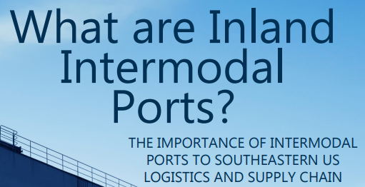
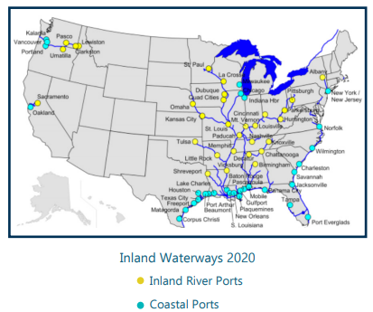
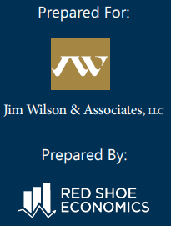
Ports & Inland Waterways: The Remaking of Our Supply-Chain to N/S
Remaking the US Supply- Chain from LA to CHI moving North/South from Gulf & SE Atlantic North to America’s 4th-Coast (Great Lakes)
26

Slide 27

Remaking US Supply-Chain: More N/S using East-Coast Ports
SAVANNAH, GA. (WTOC) - A bottleneck at Savannah’s ports. Roughly 40 ships as of Friday are anchored offshore waiting to dock.
The backup comes after congestion at West Coast ports has forced some shippers to send their cargo to Savannah. Port officials say the increased ship traffic has put a significant burden on port staff. The global race to fix pandemic-era supply chain shortages is bringing an onslaught of traffic to Savannah’s ports. “As busy as the whole supply chain has been, the burden on Savannah to play a role in handling all that cargo has grown. It’s grown well beyond what could’ve been forecasted for 2022,” Georgia Ports Authority Chief Administrative Officer Jamie McCurry said.
https://www.wtoc.com/2022/08/05/over-40-ships-anchored-offshore-waiting-enter-port-savannah/
The Port of Savannah, the busiest port on the East Coast, recorded an all-time cargo record in May as strong consumer demand and shifting inbound trade continued to drive record productivity at the port. The Georgia Ports Authority reported Wednesday that Savannah moved an all-time high 519,390 TEU in May, breaking the previous record of 504,350 TEUs set in October 2021. May volumes grew by 8.5 percent, or 40,770 TEUs, compared to the same month last year.
https://gcaptain.com/port-of-savannah-sets-all-time-record-in-may-as-cargo-surge-continues/
27

Slide 28
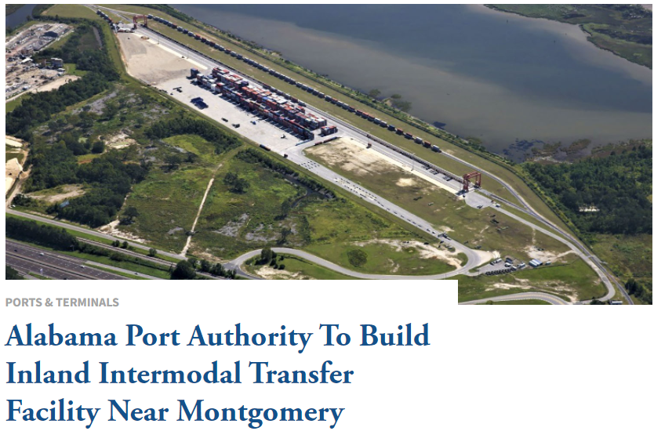
Inland Ports & the Remaking US Supply-Chain: AL Joins IP Club
February 2022: The board of directors of the Alabama Port Authority has approved the purchase of 272 acres near Montgomery, Ala., for more than $2 million. The port plans to build an inland container intermodal transfer facility at the site.
The plan has been under consideration for quite some time, driven by the desire to provide intermodal rail service from the Port of Mobile’s container terminal and the central region of the state.
“This project will provide our shippers cost-competitive transportation services to and from one of the nation’s fastest-growth containerized cargo gateways,” said John Driscoll, director and CEO of the Alabama Port Authority, the state agency that oversees the Port of Mobile.
The project, once in motion, will re-establish regular CSX intermodal rail service at the Port of Mobile, with the possibility of extending farther inland in the future. CSX has committed up to $12.5 million for infrastructure improvements for the facility.
https://www.waterwaysjournal.net/2022/02/07/alabama-port-authority-to-build-inland-intermodal-transfer-facility-near-montgomery/
28

Slide 29

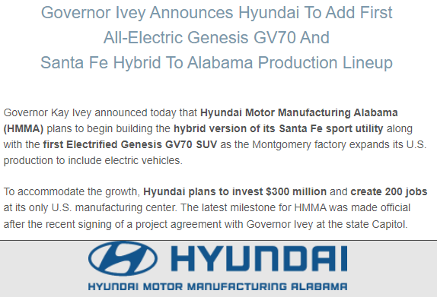

Hyundai and MORE along I-85 Corridor in AL
April 12, 2022 Breaking News
https://www.montgomerychamber.com/blog/press-releases-3604/post/governor-ivey-announces-hyundai-to-add-first-all-electric-genesis-gv70-and-santa-fe-hybrid-to-alabama-production-lineup-32891
29

Slide 30
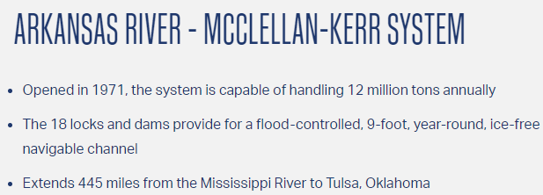
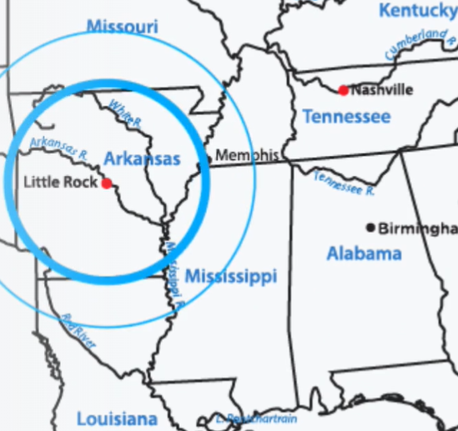

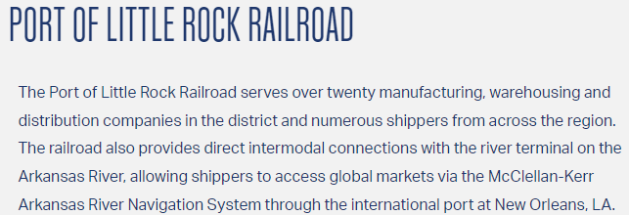


Inland Ports: The Remaking US Supply-Chain
https://www.portoflittlerock.com/
30

Slide 31
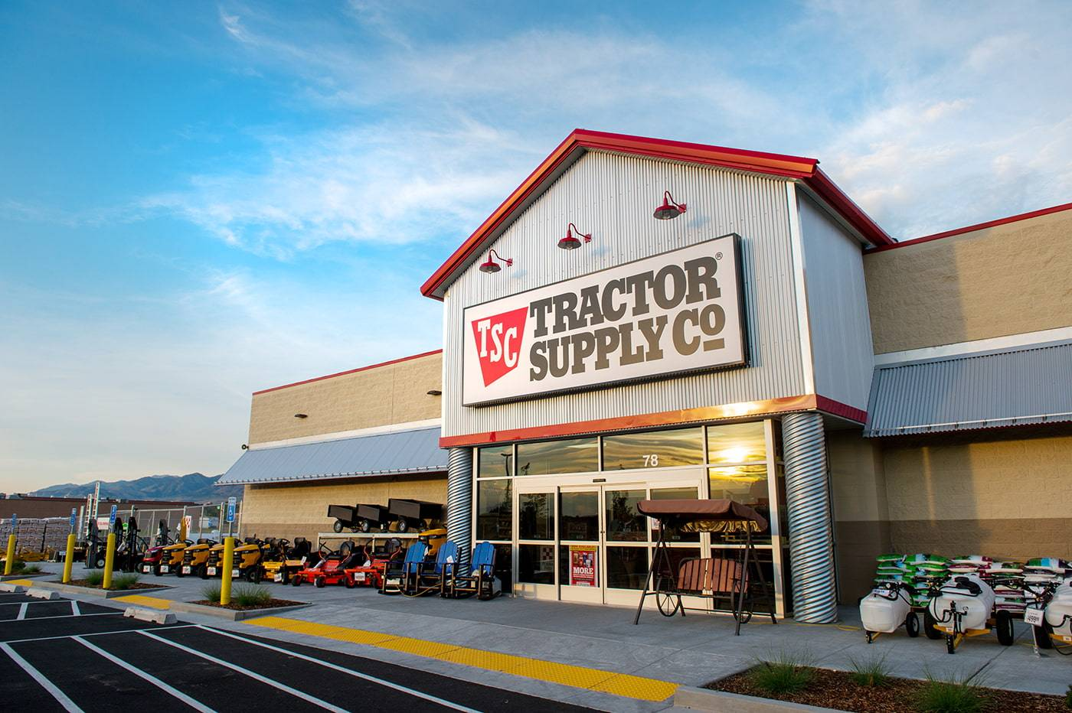
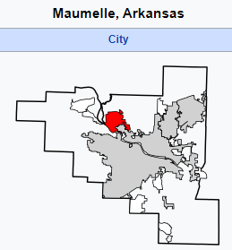
Tractor Supply to Invest $100 Million in New Arkansas Distribution Center
Tractor Supply Company Announces New Distribution Center in Arkansas
Arkansas Economic Development Commission | January 26, 2022
“We have added more than 26,000 new jobs to the state’s economy since 2015, and the creation of 450 full-time jobs will continue to boost to the state’s economy and make a big impact on Arkansas families,” Arkansas Governor Asa Hutchinson said. “Arkansas has a dedicated and skilled workforce that is ready to meet Tractor Supply Company’s needs as they embark on this newest expansion. We wish the company well as they grow and expand in Arkansas, and we are here to help them however we can.”
“This is terrific news for central Arkansas and the City of Maumelle. Tractor Supply’s new distribution center creates hundreds of new jobs for the region and once again demonstrates the strength of Arkansas’s workforce and the attractiveness of our location, infrastructure, and quality of life,” said Arkansas Lt. Governor Tim Griffin.
Tractor Supply Company (NASDAQ: TSCO), the largest rural lifestyle retailer in the United States, today announced it intends to build a new distribution center in Maumelle, Arkansas. The approximately 900,000 square foot distribution center represents an initial investment of about $100 million. The facility is anticipated to create more than 450 new full-time jobs by the end of 2023 and service about 250 Tractor Supply stores at full capacity. Construction is currently scheduled to begin in the middle of 2022, with an anticipated completion in late 2023.
From the beginning of the site search, Tractor Supply and JLL, a leading professional services firm that specializes in real estate and investment management, worked closely on the project with the State of Arkansas, Maumelle city officials, and Chris Murphy, Senior Project Manager with Entergy Arkansas. In 2019, Murphy and Tandee White, also with Entergy Arkansas, partnered with the city to certify the tract as a “Select Site” resulting in a more efficient site due diligence process for Tractor Supply.
Part of Little Rock, North Little Rock MSA
31
https://www.arkansasedc.com/news-events/newsroom/detail/2022/01/26/tractor-supply-company-announces-new-distribution-center-in-arkansas

Slide 32

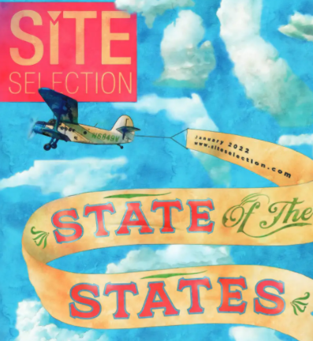


TOYOTO doubles back to NC for “Runner-Up” site
Greensboro NC
https://siteselection.com/digitalEdition/2022/jan/#page=72
32

Slide 33

MS Economic Wins: Columbia Industries to Invest $9.5M
Columbia Industries, LLC, oilfield and solid waste equipment manufacturer, is locating operations in Starkville. The project is a $9.549 million corporate investment and will create 62 jobs.
Columbia Industries is relocating to Starkville from Hillsboro, Oregon. The company specializes in the custom design and fabrication of oilfield equipment, including rig walking systems, fast-moving and self-propelled wheeled systems, module and camp trailers, pipe handling equipment and hydraulic power units. Columbia Industries’ solid waste equipment includes landfill tippers, fixed installation tippers, customized support tippers and truck dumpers.
“The Columbia Industries team found the ingredients for success in Starkville. In addition to being home to Mississippi State University, Starkville’s proximity to East Mississippi Community College and the pipeline of skilled workers trained there will be invaluable to Columbia Industries today and well into the future. I thank the Columbia Industries team for placing their faith in our strong business environment and for their investment in the future of the region’s workforce.” – MDA Deputy Executive Director Laura Hipp
https://mississippi.org/news/columbia-industries-locating-manufacturing-operations-in-starkville/
33

Slide 34

MS Golden Triangle within the RSE US Golden Triangle
ALTEX Tube investing $110M in new steel tube manufacturing plant.
Altex Tube LLC is locating a new manufacturing plant in Columbus. The project represents a corporate investment of nearly $110 million and will create 58 direct jobs.
Altex Tube, which is locating on the Steel Dynamics campus in Golden Triangle Industrial Park, will manufacture black and pre-galvanized steel tubing in various sizes using coil products produced by SDI.
“As a Mississippi State graduate, I’m thrilled to be relocating back to Mississippi. Altex Tube is thankful for local and state support throughout this process of building a world class HSS and mechanical tube mill in the Golden Triangle. Our new mill, supplied by MTM Spa, will utilize the latest technologies available to manufacture black and pre-galvanized steel tubing ranging in size from 1 inch to 6 inches square and 1.25 inches to 7.625 inches round, up to 48 feet in length and thicknesses ranging from .060 inches to .375 inches. Altex Tube will be built in two phases with phase one scheduled to be operating by mid-2023.” – Zach Smith, President and CEO, Altex Tube
https://mississippi.org/news/altex-tube-llc-locating-manufacturing-operations-in-columbus/
34

Slide 35


Terberg and Taylor: New Terminal Tractor Manufacturing Facility
Terberg Taylor Americas Group, LLC will establish a manufacturing facility in Lowndes County, Mississippi and build up a distribution network for the sales, after-sales and rental of Terberg terminal tractors. The project is a $15.9 million corporate investment and will create 90 jobs. The first terminal tractor is expected to be built in the third quarter of 2023.
“The Taylor Group of Companies and Royal Terberg Group global partnership is a testament to the strength and success of Mississippi-rooted companies. Mississippi is a prime location for global partnerships. With the state’s low cost of doing business and market access with our ports and highways, transport of products – domestic and international – happens with ease.” – Governor of Mississippi, Tate Reeves
“Taylor has enjoyed our relationship with Terberg. We are excited to bring these products and manufacturing to the U.S. and Mississippi. This facility will be a state-of-the-art factory where the best terminal tractors in the world will be built.” – Robert Taylor, President and COO, Taylor Group of Companies.
https://www.terbergspecialvehicles.com/en/news/terberg-and-taylor-join-forces-to-manufacture-and-distribute-terminal-tractors-in-the-united-states/
35

Slide 36


Dunn Utility Products to Double Concrete Manufacturing Facility
Mississippi-based company Dunn Utility Products will almost double its workforce through a $23.3 million expansion in New Albany that will add 30 new jobs.
The company manufactures reinforced concrete pipe and precast concrete and is expanding into the Enhance Mississippi Shell Building in New Albany. The 100,000-square-foot shell building in Union County will house two new manufacturing plants to produce concrete pipe and wet cast concrete.
In addition to the 100,000-square-foot building, Dunn Utility Products also purchased a dirt pad at the site that could accommodate another 100,000 square feet. Ultimately, the building could be expanded to 400,000 square feet.
https://mississippi.org/news/dunn-utility-products-plans-multimillion-dollar-expansion-in-new-albany/
36

Slide 37

MS Receives $15.4M for Transportation Infrastructure Projects
Three grants totaling $15.4 million awarded for infrastructure projects in Yazoo City, Tupelo, and Ripley. The three grants, which are specifically designed for local projects, were awarded by the U.S. Department of Transportation (DOT) through the Rebuilding American Infrastructure with Sustainability & Equity (RAISE) grant program.
The three RAISE grants for Mississippi include:
Yazoo City Main Street Revitalization Project (Yazoo City): $12,641,440 for the construction of a train station, development of a stormwater park, and street-level redevelopment that would include bike lanes, broadband, and stormwater management.
Tanglefoot Trail Extension (Ripley): $1,400,000 for planning operations regarding a potential 20-mile expansion of the Tanglefoot rail from New Albany to Ripley.
Tupelo RAIL Improvements Program: $1,452,290 for engineering and planning work to construct a highway overpass at Eason Boulevard and Kansas City Southern Crossing; work to change the location of the switching operation away from the intersection at Main Street and Gloster Street; develop quiet zones; and install new safety features.
https://www.wicker.senate.gov/2022/8/wicker-hyde-smith-welcome-15-4m-in-infrastructure-funding-for-mississippi
37

Slide 38

Jackson MS Water Crisis: Damage to Future Economic Development
NOT what industry, Chamber of Commerce or any entity considering MS for future Site Selection want to hear:
More than 150,000 residents of Jackson, Miss., remained without access to safe drinking water Tuesday, a day after officials announced that the city’s main treatment plant had failed, creating an emergency that could last “indefinitely.”
State and local leaders scrambled to address the crisis, which will require an unprecedented mobilization effort to provide water for flushing toilets, cooking and bathing.
https://www.wicker.senate.gov/2022/8/wicker-hyde-smith-welcome-15-4m-in-infrastructure-funding-for-mississippi
38

Slide 39


LMI Metric for Logistics: 5 Universities + 2 Leading LIs on Supply-Chain
Inventory costs way up as not enough warehouse, trucker, etc. capacity.
Inventory Costs - UP
June 2021 LMI (Logistics Managers Index) = 75.0
June 2021’s LMI comes in at 75.0, the second-highest in the history of the index. The overall index rate has now come in above the 70-point mark in five consecutive months, the longest streak in the history of the LMI.
LMI Methodology: The LMI score is a combination of eight unique components that make up the logistics industry, including: inventory levels and costs, warehousing capacity, utilization, and prices, and transportation capacity, utilization, and prices. The LMI is calculated using a diffusion index, in which any reading above 50 percent indicates that logistics is expanding; a reading below 50 percent is indicative of a shrinking logistics industry.
Warehouse Capacity - DOWN
http://www.the-lmi.com/june-2021-logistics-managers-index.html
39

Slide 40









Logistics & Supply-Chain Resources
Site Selection Magazine – SiteSelection.com
Journal of Commerce – JOC.com
gCaptain
American Association of Railroads (aar.org)
Freight Waves - Freightwaves.com
LMI (Logistics Managers Index) LMI.org
CBRE – “Retail to Industrial Conversion” Flash reports - Summer 2020
Port Websites and Retailer Websites and 10(q) Quarterly SEC Filings (Great Intel)
Site-To-Do-Business (STDB.com)
40

Slide 41

L&T Risks to Monitor: Amazon Overbuilt Warehouse Capacity
The online retail giant is seeking to sublease a minimum of 10 million square feet of warehouse space and is also exploring options to end or renegotiate leases with outside warehouse owners, according to a person familiar with the matter. The move follows the first quarterly loss in seven years for the company, which in April reported a decline in demand that has strained its warehouse operations after roughly two years of outsize growth.
While Amazon is still determining exactly how much space to vacate, the amount is expected to be at least 10 million square feet, though it could eventually extend to double or triple that, the person said. The company has more space than it needs in some of its largest markets, including in New York, New Jersey, California and Atlanta, the person said. Bloomberg earlier reported on Amazon’s aim to shed space and locations that could be affected.
Amazon’s legendary e-commerce machine has recently stalled. The company in April reported its slowest growth in about two decades, with its quarterly products sales having flatlined and revenue at its online shopping business declining by 3%, the worst mark since the metric was first disclosed in 2016.
https://www.wsj.com/articles/amazon-plans-to-sublet-warehouse-space-to-reduce-excess-capacity-11653335430?st
41

Slide 42

AMAZON’s Space Glut: Rent Trends in Potential Markets for Reduction
42

Slide 43

L&T Risk: Western Water/Drought & Mexico for Industrial Site Selection?
Hard Choices for the Colorado River
Emerging Industrial Market: Monterrey, Mexico (CBRE 8/22)
The seven Colorado River states – Arizona, California, Colorado, New Mexico, Nevada, Utah, and Wyoming face a daunting mid-August deadline. The federal government has asked them to come up with a plan to reduce their combined water usage from the Colorado River by up to 4 million acre-feet in 2023.
That’s a massive reduction for a river system that currently produces about 12.4 million acre-feet. The Bureau of Reclamation, which manages the Colorado River, warned that it will “act unilaterally to protect the system” if the states cannot develop a plan on their on.
This leads the Commission to conclude that any future reductions must come largely from Mexico and the Lower Basin states of Arizona, California, and Nevada because the use most of the water.
Monterrey is the capital of Mexico’s northeastern state of Nuevo León. The city is a three-hour drive southwest of the US border in Texas and has a strong manufacturing base.
The Monterrey region has convenient air cargo service.
As of Q2, Monterrey’s overall industrial vacancy rate was just 2.5%, down by more than 2% since Q1. More than 9.3 million SF of new construction is currently underway, including a 2.3 million SF manufacturing.
Manufacturing accounts for 52% of leased space in the Monterrey region, followed by the automotive (25%) and transportation & logistics (8%) sectors.
Manufacturers looking for Water outside the West & Mexico offers Workforce Advantages.
Emerging Industrial Market: Monterrey, Mexico | CBRE
43

Slide 44


NIMBY Risk to Monitor: Anti-Warehouse Movement in SoCal spreads
The California State Assembly will soon be voting on AB 2840.
AB 2840 would ban the building of any facility 100,000 sf or more within 1,000 ft of a “sensitive receptor,” which has a broad definition but is basically most non-industrial uses. Additionally, all projects that are not banned due to proximity to a sensitive receptor must have a Project Labor Agreement (PLA) to be approved.
AB 2840, authored by Assemblywoman Eloise Gómez Reyes (D-San Bernardino), passed the Assembly Local Government Committee on April 20 and the Assembly Appropriations Committee on May 11.
Even if your company doesn’t build or own these types of facilities, the precedent set by this bill will have a significant impact on all commercial real estate projects in the future and has the potential to undo years of investments on permits, construction and project development.
“We are urging all NAIOP SoCal members and the entire California commercial real estate industry who have not yet taken action to voice their opposition to AB 2840 with their respective State Assembly representative.”
https://www.naiopsocal.org/warehouse-ban/
44

Slide 45

L&T Risks to Monitor: Automation in Logistics and the Warehouse
Watch FedEx Logistics! Forget robots and think autonomous everything displacing workforce!
FedEx Logistics Opens Global Headquarters in Memphis April 06, 2022 FedEx Corporation
Logistics subsidiary of shipping giant FedEx (NYSE:FDX) has opened a new global headquarters in downtown Memphis, Tennessee.
The company has invested more than $50M to renovate the building.
Udo Lange, president & CEO of FedEx Logistics said, “From this magnificent facility, our employees will collaborate, innovate, and serve our global customers.”
A subsidiary of FedEx Corp., FedEx Logistics said it provides air and ocean cargo, warehousing and distribution, customs brokerage and other services to customers.
On March 30, 2022, the company announced its intention to begin testing of Elroy Air's Chaparral autonomous air cargo system next year.
But… Look UP… Drone Deliveries for Pet Meds & Ice Cream are Reality in TX:
The first commercial drone deliveries in the U.S. will take off today (April 8 ‘22) as Alphabet's Wing unleashes its aircraft over the suburban towns of Frisco and Little Elm, which are located just north of Dallas, Texas. If successful, the service could revolutionize how goods are currently transported around cities. Wing has partnered with Walgreens, Blue Bell Creameries, Easyvet, and Texas Health for the initial rollout, meaning consumers will be able to order prescription pet meds and ice cream, among other items. (SeekingAlpha.com).
https://seekingalpha.com/news/3821019-fedex-logistics-opens-global-headquarters-in memphis?
45

Slide 46



ESG: Think about the following as applied to CRE
Q. What is biggest HEADWIND to ESG and CRE?
A. NIMBY fighting ESG Infrastructure like HVTLs that transmit the renewable energy to where it is needed in cities, at factories and Commercial RE Buildings.
B-A-N-A-N-A
Build Absolutely Nothing Around Nobody Anywhere
46

Slide 47


ESG Scoring: Scoring Requires Evolution
The term ESG (Environmental, Social and Governance) originated in 2005 when the World Bank hosted the Who Cares Wins Conference to ‘examine the role environmental, social, and governance indicators’ could have on capital markets
UN’s Principles for Responsible Investment (PRI) was subsequently founded in 2006 to ‘provide a blueprint of responsible investment’
Institutional Shareholder Services (ISS) launched their own version of ESG scoring in 2018 with the Environmental & Social Quality Score
Glass Lewis released their own ESG profiles using Sustainalytics’ ESG Ratings
IREM now offers a Certified Sustainable Property (CSP) certification with points earned for features such as:
2 of 3 ESG Scoring entities in US get the Red Shoe Economics “BBQ-Sauce” award.
https://www.newtimes.co.rw/business/who-cares-wins-esg-standards-are-taking-over-investment-sphere
47

Slide 48

ESG Investing: Property Assessed Clean Energy (PACE) Financing
PACE
Property Assessed Clean Energy
TX Pace Authority Tops in US
Charlene Heydinger, President of TX PACE
Charlene@TexasPACEAuthority.org
Commercial Property Assessed Clean Energy (C-PACE) is a financial tool for property owners to obtain low-cost, long-term financing for energy efficient equipment, renewable energy, and water conservation projects.
C-PACE can provide up to 100% funding of total project costs by placing a special voluntary assessment on the property that repays the costs of the upgrades. Because C-PACE is attached to a property assessment, it is a very secure form of financing.
C-PACE financing is a voluntary program. The loan payment is added to the property tax bill and collected as an assessment by the county/municipality.
https://www.lonestarpace.com/wp-content/uploads/2022/02/0821sWgpT-Generic-Sell-Sheet-sm.pdf
48

Slide 49


One Final CRE Risk to Monitor:
The Solar System & Neptune Star
https://www.newscientist.com/article/2327042-a-passing-star-shifting-neptunes-orbit-could-wreck-the-solar-system/
49

Slide 50

RedShoeEconomics.com
Red Shoe Economics is an independent research and consulting firm exclusively serving today's commercial real estate community providing organic research initiatives, reports and insights on the impact of applied Economics on our industry. The company's four pillars include Economics, Forecasting, Valuation and Consulting.
Our promise is to deliver unique content providing the most comprehensive, concise and cutting-edge information on the economic impacts on commercial investments, trends and transactions - eight days a week! As a WOSB, Red Shoe Economics is dedicated to giving back to the industry we serve by furthering the advancement of women in commercial real estate.
Economics
Forecasting
Valuation
Consulting
KC Conway, CCIM, CRE, MAI
Principal, Futurist
Beverly Keith, CCIM, CRE, CRX
Principal, Business Strategist
Caylinn Peterson, CCIM
Project Research Strategist
Stacy Barrington
Corporate Operations Strategist
Macro and Micro Analysis
Rezoning Impact Analysis
Corporate Earnings Analysis
Ports & Logistics Industry Trends
Housing Economics
Commercial Real Estate Impacts
State & Local Government Taxation
Current CRE Conditions
Association Presentations
Red Shoe Review
Industry/Corporate Webinars
Podcasts/Articles/
SME Interviews
Real Estate Finance reports
Special Projects (LIHTC or NIMBY)
USPAP Appraisal Review
Bank Regulatory Compliance
Valuation Analysis
Highest & Best Use Advisory
Property Tax Expert Witness
Adaptive Reuse Advisory
Site Selection Validation
Financing Feasibility
Market & Feasibility Studies
Ports & Logistics Advisory
Retail Industry Insights
ESG / DEI Advisory at CRE level
ArcGIS StoryMap Building
50

